Slide 1

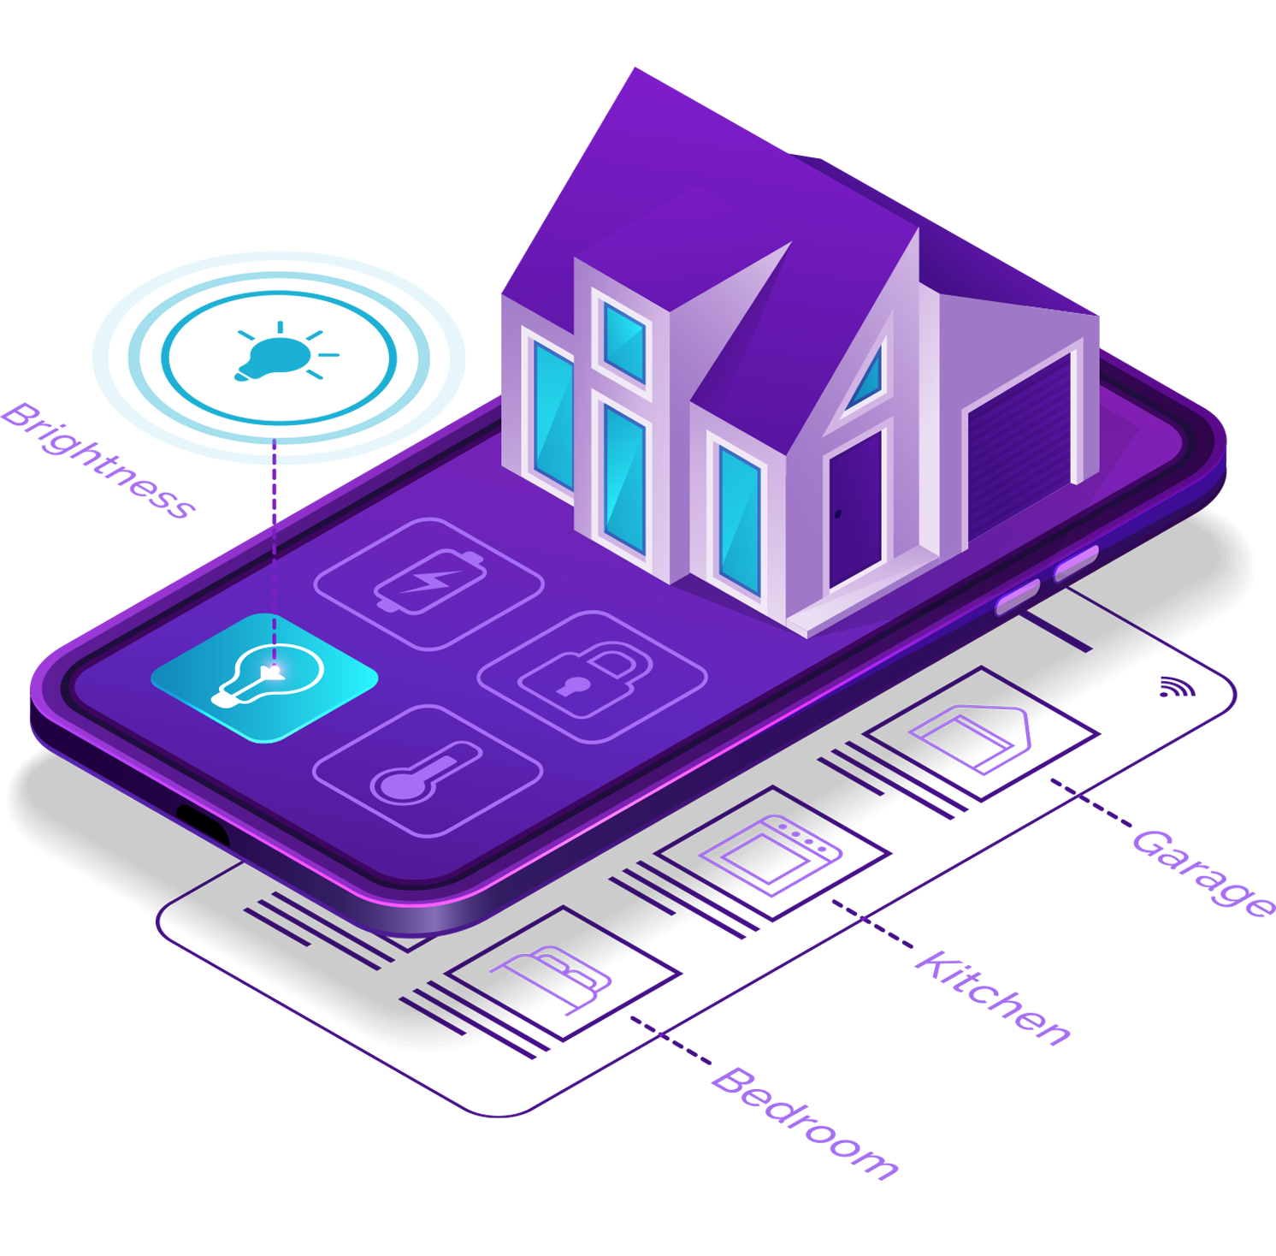
Smart Home Automation System
A Java-based smart home automation system to control and manage various aspects of your home from a central hub.

Slide 2

Group members:
2020ICTS093 A.K.M.Aslam
2020ICTS076 A.M.Muzakkir
2020ICTS091 I.F.Ishara
2020ICTS094 F.F.Asoora
2020ICTS113 K.A.A.V.N.Kahadawa

Slide 3
System Overview
System Architecture
User Authentication
The smart home automation system is comprised of several key components that work together seamlessly.
Register and authenticate users to ensure secure access to the system's functionalities.
Efficient power console
How the OOP concepts are implemented
Control and manage your kitchen activities for a seamless cooking experience.
Effortlessly manage the user data in your home to create the perfect ambiance for any occasion.

Slide 4

User Authentication
1
Register and Authenticate
2
Seamless Access
Create user accounts and ensure secure access with username and password authentication.
Login with ease using your unique credentials for a hassle-free experience.
3
Password Reset
If you ever forget your password,
easily reset it to regain access to your smart home system.
4
OOP Concepts
Encapsulation: Private instance variables and getter and setter methods for accessing and modifying the user's data.

Slide 5
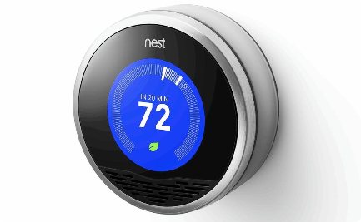
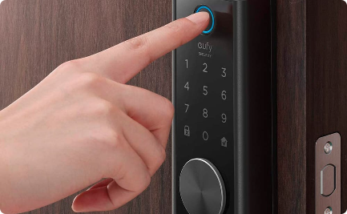
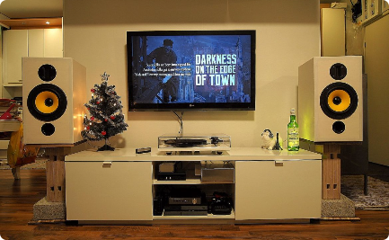
Smart Device Control
Thermostat Control
Smart Lock Control
Entertainment System Control
Efficiently manage and adjust the temperature in your home for ultimate comfort.
Securely control access to your home by managing your smart locks.
Enjoy immersive entertainment experiences with control over your smart home devices.
OOP Concepts
OOP Concepts
Encapsulation
Polymorphism
Inheritance
Polymorphism
Inheritance

Slide 6
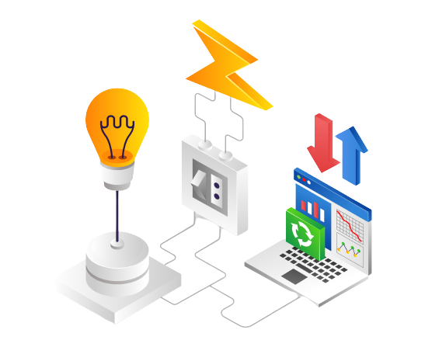
Lighting Control
1
Check Light Status
Quickly check the status of lights
in different
rooms and adjust accordingly.
2
Select a Room
Easily choose a specific room
and manage its lighting
settings effortlessly.
3
On/Off Control
Turn lights on or off in a particular
room with a simple tap or click.
OOP Concepts : Inheritance , Polymorphism

Slide 7

Family Information
1
Add Family Members
Keep track of your family members by adding their information to the system.
2
Update Arrival Status
Receive real-time updates on the arrival status of your loved ones for peace of mind.
3
Display Arrival Status
View the arrival status of your family members,
ensuring everyone's safety and well-being.
OOP Concepts : Encapsulation

Slide 8

Reminder System
1
Add Reminders
Set reminders for important events and
tasks to stay organized and never miss a beat.
2
View Existing Reminders
Easily access and view your existing
reminders for a seamless workflow.
OOP Concepts : Encapsulation

Slide 9

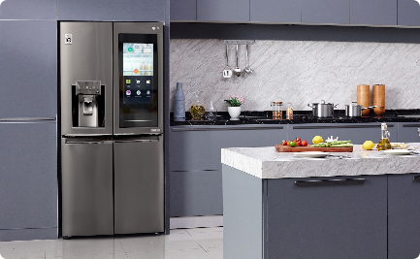

Kitchen Management
Meal Status
Lunch and Dinner
Daily Menu
Check the status of your meals and never miss a cooking step.
Prepare delicious and nutritious meals with smart kitchen appliances and utensils.
Create and view your personalized daily menu, and stay organized in the kitchen.
OOP Concepts : Encapsulation

Slide 10
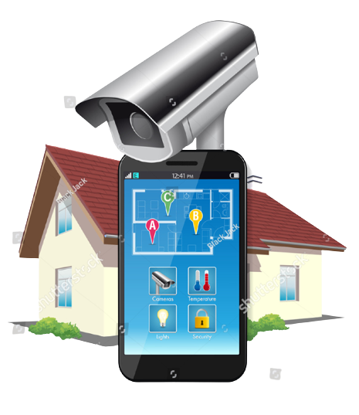
Security System
1
Activate the Security Alarm
Ensure the safety of your home by activating the comprehensive security alarm system.
2
Deactivate the Security Alarm
Easily deactivate the security alarm when you are at home or during authorized entry.

Slide 11

Conclusion
The Smart Home Automation System effectively applies core OOP concepts, organizing code with classes and objects, securing data via encapsulation, promoting code reuse with inheritance, employing polymorphism for diverse device control, and simplifying interaction with devices through abstraction.

Slide 12


Slide 13


